Slide 1
MDRisk Stratify: AI-driven MDR Prediction for Optimized Antibiotic Use in LMICs
Group 3
Ogenrwot Jerome Bright
Hawa Hassan Mzee
Racheal Claire Kyomukama
Haumba Comfort Jonathan
Ategeka Sharon
Patricia Mystica Apio
Abraham Byomugabe

Slide 2
Introduction
AMR is a major public health emergency: pathogens are increasingly resistant, making standard treatments ineffective.
By 2050, projections estimate 1.91M deaths attributable to AMR and 8.22M deaths associated with AMR worldwide.
AMR is well established:
Resistance to first-line antibiotics >50% (Flemming Fund report)
Limited structured surveillance systems hinder effective monitoring and response.
Bridging the Data Gap
The ATLAS dataset provides isolate-level data for WHO priority pathogens.
This dataset is critical for tracking resistance trends, informing policy, and guiding clinical decision-making.
¹Global burden of bacterial antimicrobial resistance 1990–2021: a systematic analysis with forecasts to 2050 Naghavi, Mohsen et al. The Lancet, Volume 404, Issue 10459, 1199 - 1226

Slide 3
Problem statement
Turnaround Time: Culture & sensitivity tests take 3–4 days, delaying targeted treatment.
Clinical Practice: Clinicians rely on empirical prescription of antibiotics based on symptoms and provisional diagnosis.
Patient Impact: Leads to antibiotic resistance and poor outcomes when prescribed drugs that are ineffective.
Resource Gap: In low-resource settings like Uganda, many patients cannot access culture & sensitivity tests at all since we lack the resources.
Lack of rapid diagnostics means resistant strains spread unchecked in communities and hospitals.

Slide 4
ML solution
AI-powered ML model to provide provisional culture & sensitivity results within hours.
Enables clinicians to choose antibiotics that are likely to be effective earlier, reducing trial-and-error prescribing.
Improves patient outcomes, lowers costs, and slows the spread of AMR.
Designed for low-resource settings, bridging the diagnostic gap where lab infrastructure is limited.

Slide 5
Multi-output classification
Step | Description
🧩 Input Features | Patient demographics, lab results, symptoms
🔗 Shared Representation | Model learns common patterns across outputs
🎯 Multiple Heads | Each output layer predicts a separate label (e.g., antibiotics such as amikacin, ampicillin, etc.)
🔄 Joint Optimization | Loss functions combined to train all outputs together
A machine‑learning task where a model predicts multiple labels or outcomes simultaneously for each input.
Each output corresponds to a different target variable, often related but not identical.
Example: Predicting antibiotic resistance profile from patient data.

Slide 6
Data Description
Data features
Patient demographics: age, sex, inpatient/outpatient status.
Specimen source: blood, urine, wound, respiratory, sterile fluids.
Organism identification: genus and species.
Antimicrobial susceptibility results: Susceptible (S), Intermediate (I), Resistant (R) per CLSI guidelines.
Resistance markers: ESBL, carbapenemase, MRSA.
Specification | Description
Dataset name | ATLAS datasets
Data type | Secondary observational
Format | CSV / Excel
Records | 966805
Variables | 134
Geographic coverage | Multiple hospitals, in Africa, Europe and Asia
Source | Vivli AMR Register
Access | https://vivli.org
Ethical approval | Not required (de-identified data)

Slide 7
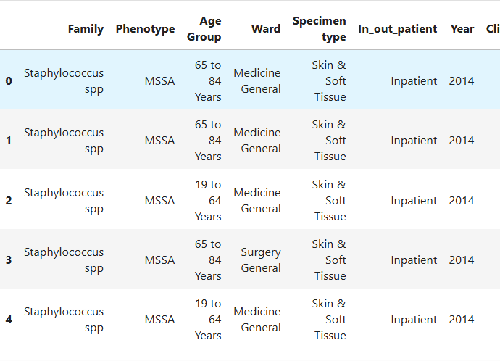
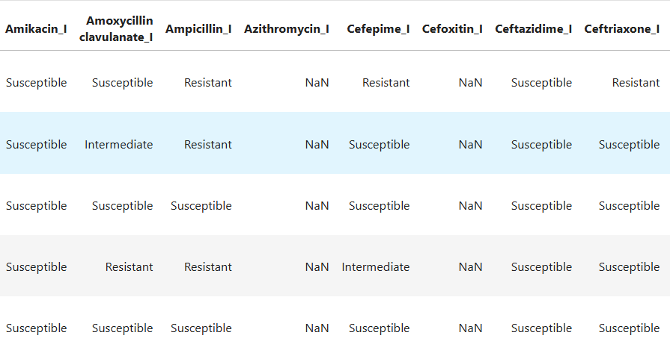
Data description

Slide 8
Methodology
Data acquisition (Extract anonymized data from vivli register)
Exploratory Data Analysis
Data preprocessing
(Handle missingness, ensure data consistency)
Model interpretation
(Feature importance)
Interpretability
Machine learning algorithms
(Random forest, Extra Tree classifier, Decision tree, etc.)
AI-Ready Dataset
Best
Model
Model training
and testing
Antibiotic resistance profile
Resistance (1), Not resistance (0)
Predict outcome

Slide 9
Classifiers
Decision tree classifier
Random Forest classifier
Splits data into branches based on feature thresholds.
Simple, interpretable, but prone to overfitting.
Ensemble of many decision trees
More complex and less interpretable
Uses majority vote/average its more robust and accurate
Extra tree classifier
K-Nearest Neighbors (KNN)
Similar to the random forest but adds extra randomness in splits
Faster training, reduces variance
Less interpretable
Classifies based on closest data points in feature space
Simple, non parametric
Computationally heavy for large datasets

Slide 10
Metrics
Hamming loss : The fraction of labels that are incorrectly predicted.
Interpretation: Lower is better (0 means perfect prediction).
Precision : Out of all the predicted positives, how many are positive.
Interpretation: High precision means fewer false alarms. Useful when false positives are costly (e.g., predicting an antibiotic being susceptible yet its resistant).
Recall : Out of all actual positives, how many were correctly predicted.
Interpretation: High recall means fewer missed cases. Useful when false negatives are costly (e.g., failing to detect resistance).
Accuracy : Overall proportion of correct predictions.
Micro F1: Calculates metrics globally by counting total true positives, false negatives, and false positives across all classes.
Good for imbalanced datasets because it gives more weight to larger classes.
Macro F1: Calculates F1 score for each class independently, then averages them.
Treats all classes equally, regardless of size. Good for evaluating performance across minority classes.

Slide 11
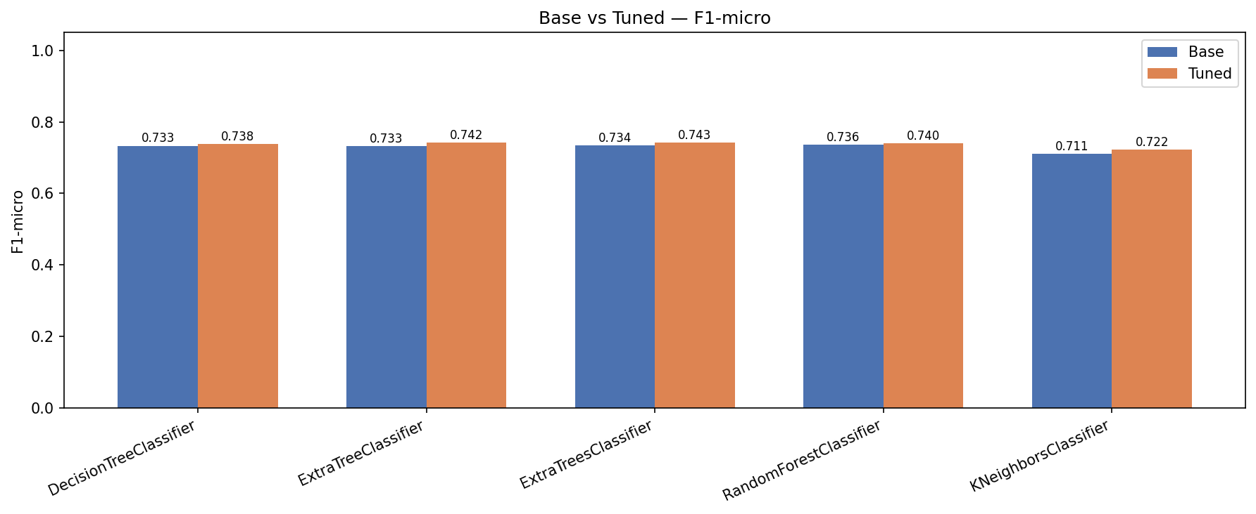
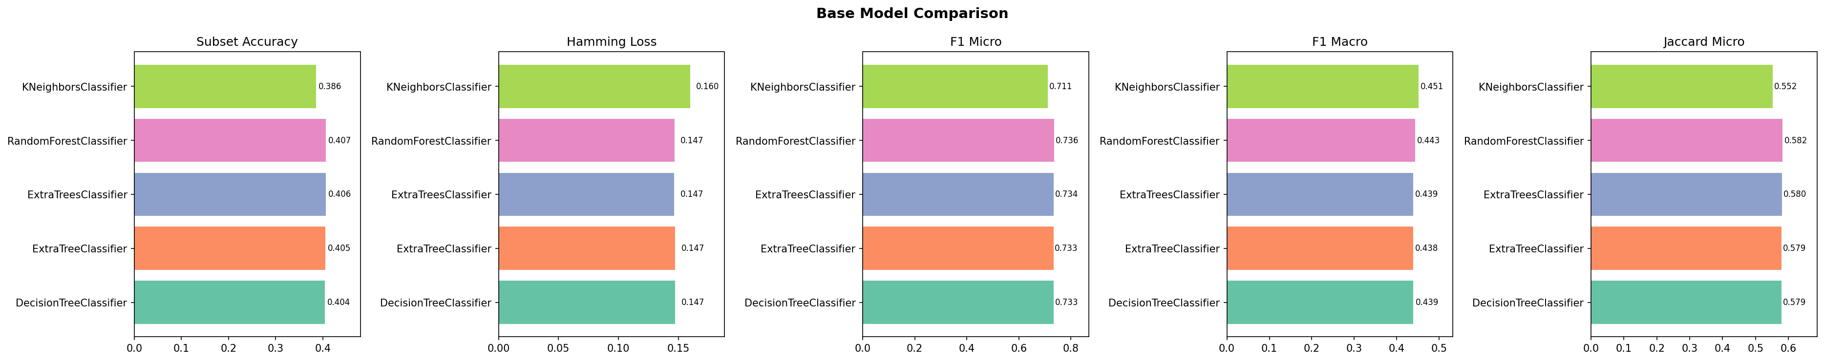
Staphylococcus aureus
 | Precision | Recall | F1-score
Clindamycin | 0.64 | 0.65 | 0.64
Erythromycin | 0.67 | 0.79 | 0.73
Levofloxacin | 0.71 | 0.85 | 0.77
Moxifloxacin | 0.68 | 0.84 | 0.75
Oxacillin | 0.88 | 0.78 | 0.83

Slide 12
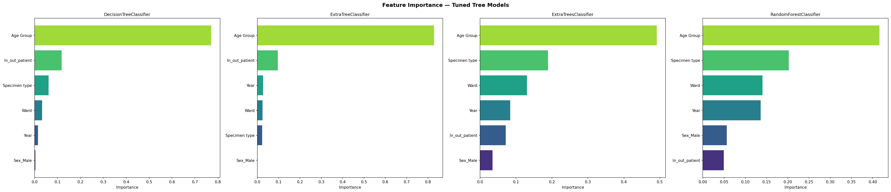
Feature importance

Slide 13
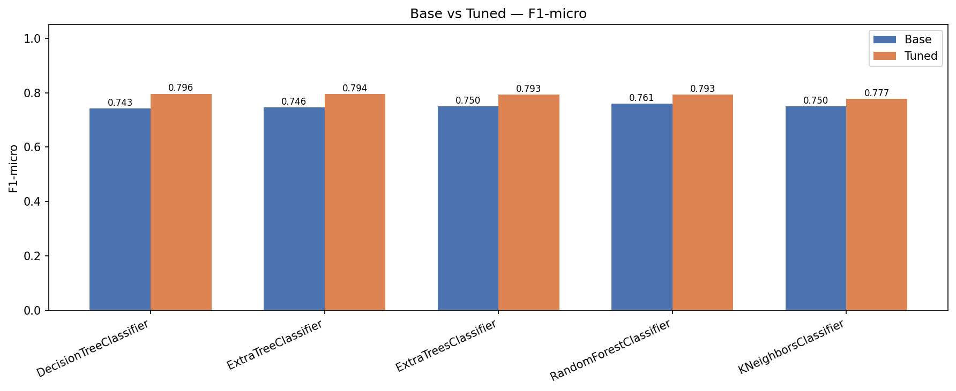
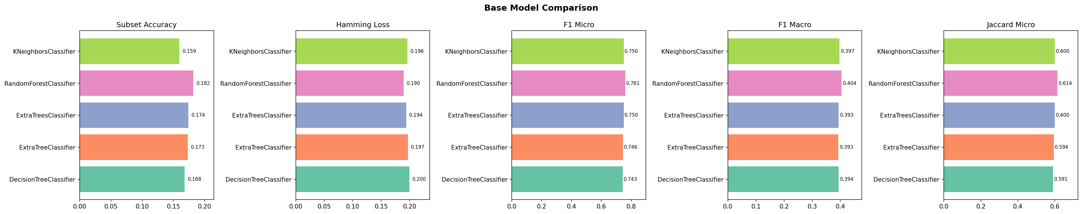
Escherichia coli
 | Precision | Recall | F1-score
Ampicillin | 0.95 | 0.86 | 0.74
Cefepime | 0.68 | 0.80 | 0.74
Ceftazidime | 0.58 | 0.94 | 0.72
Levofloxacin | 0.79 | 0.88 | 0.83

Slide 14
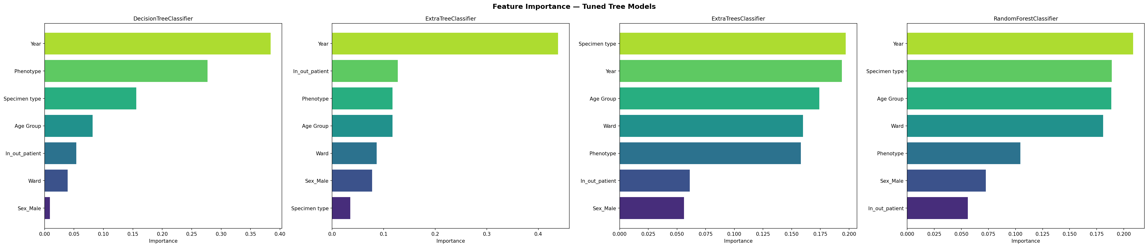
Feature importance

Slide 15
Conclusion
AI-driven multi-output models can address AMR challenges in low-resource settings.
Using the ATLAS dataset and classifiers (Random Forest, Extra Trees, Decision Trees), we predicted resistance profiles for Staphylococcus aureus and Escherichia coli.
Staph aureus: Oxacillin & Levofloxacin showed strong precision/recall → reliable resistance detection.
E. coli: Levofloxacin balanced metrics well; Ampicillin highlighted precision–recall trade-offs.
Evaluation metrics (Hamming loss, precision, recall, accuracy, micro/macro F1) ensured fair assessment across majority & minority classes.
Impact: Faster diagnostics, better antibiotic choices, reduced empirical prescribing, improved outcomes, and slowed AMR spread.
Code availability: https://github.com/RachealClaire/ML_group_work.git

Slide 16
Thank you

